Slide 1


Flutter Intro
József Lurvig

Slide 2

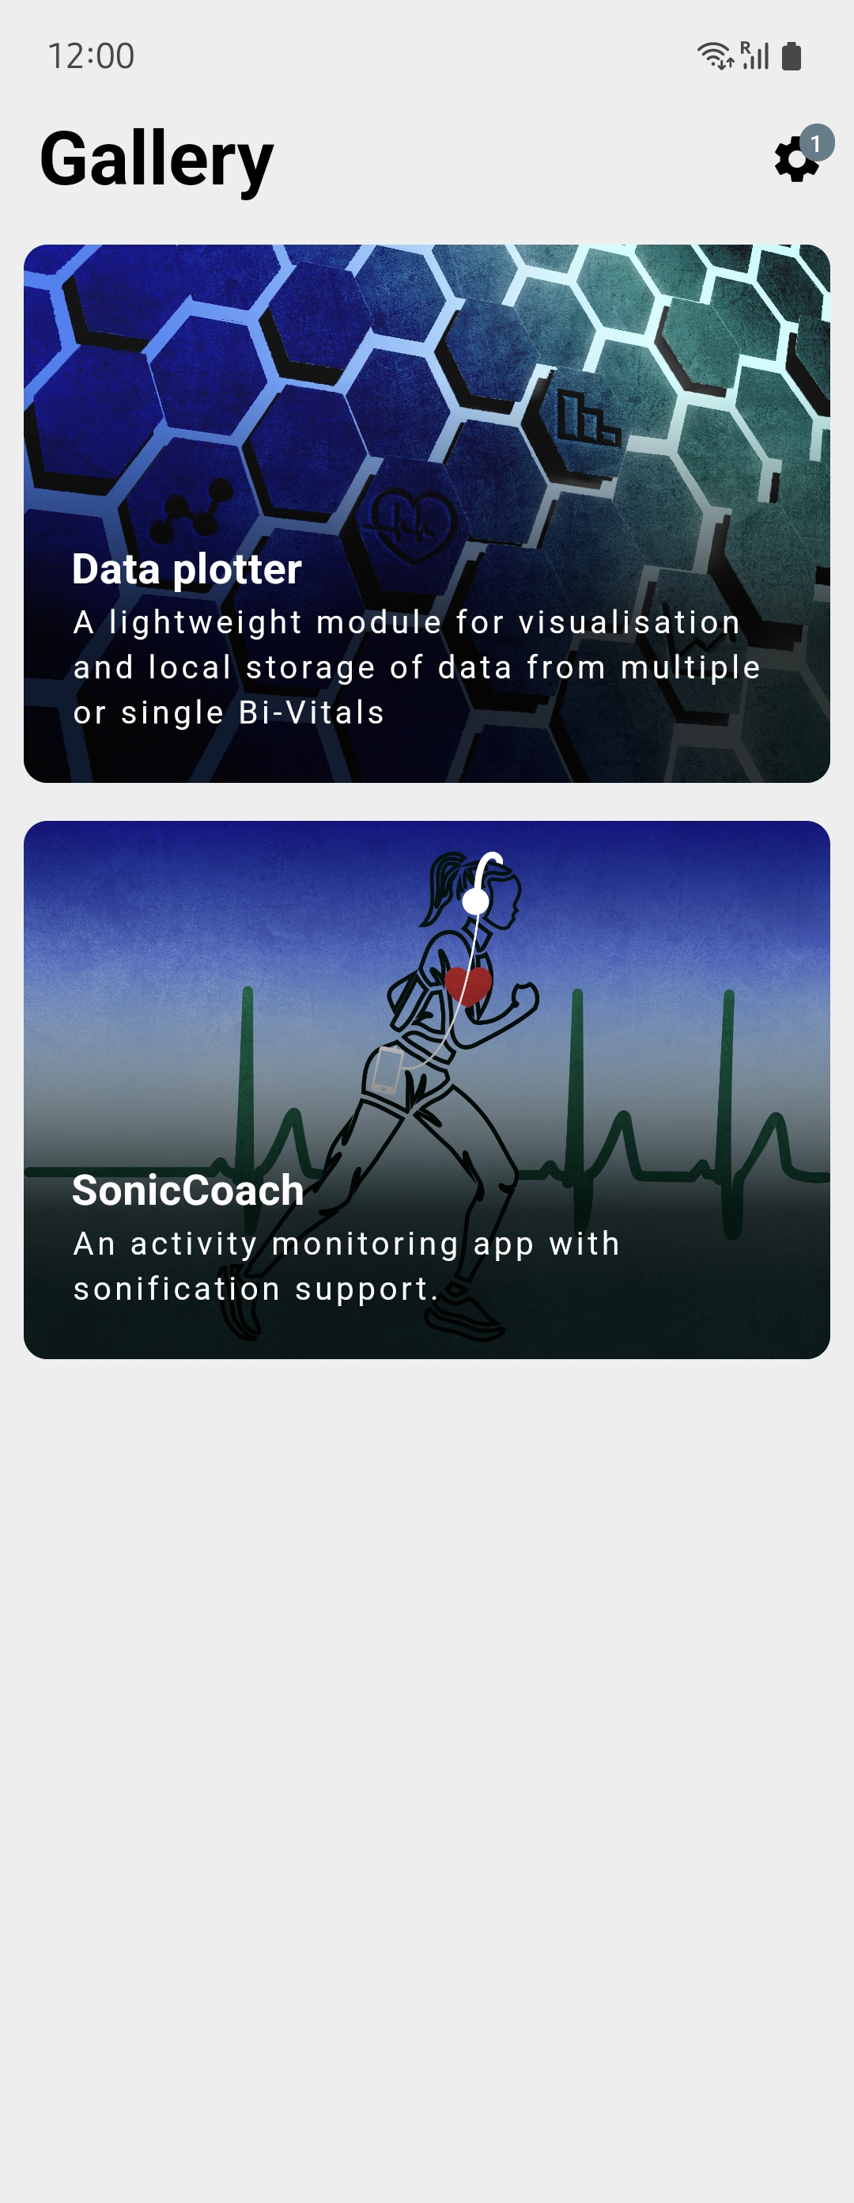


Slide 6


Slide 7
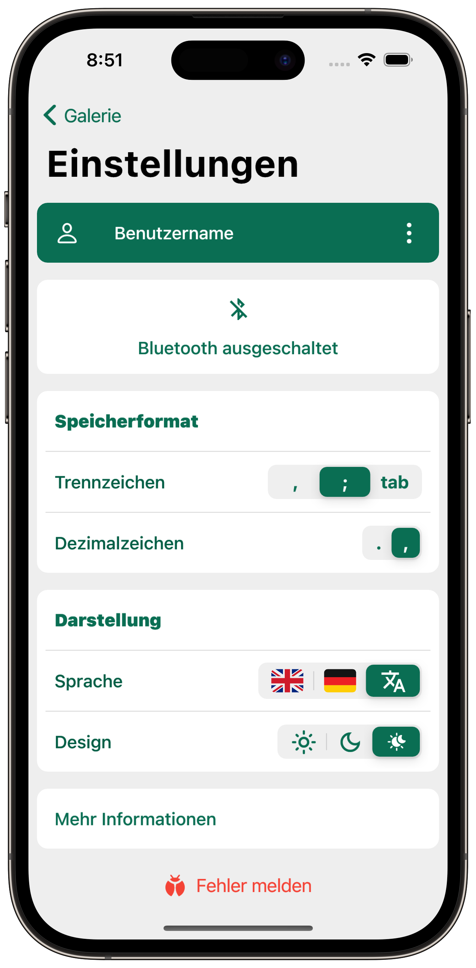
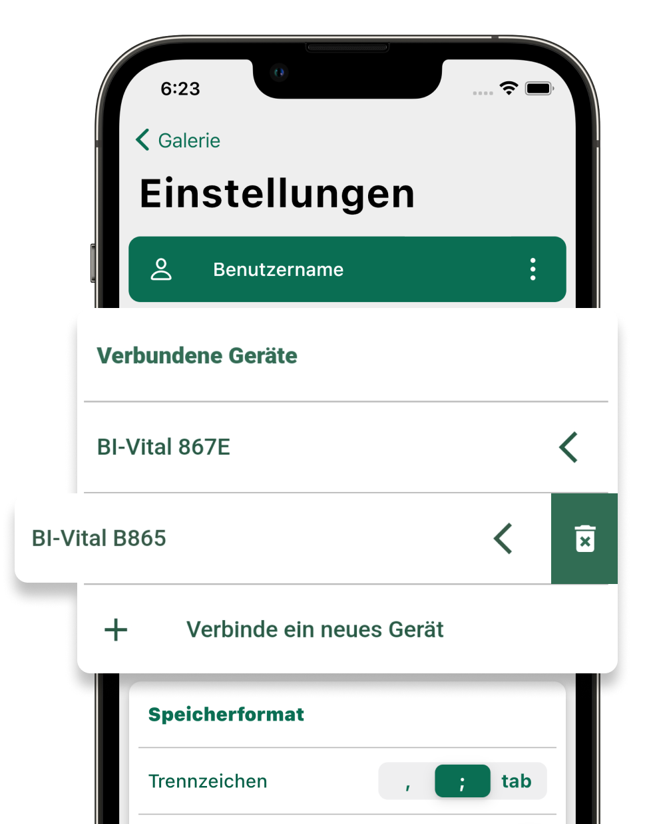
CSV formatting
Change username
Change language and theme
Connect new devices

Slide 8
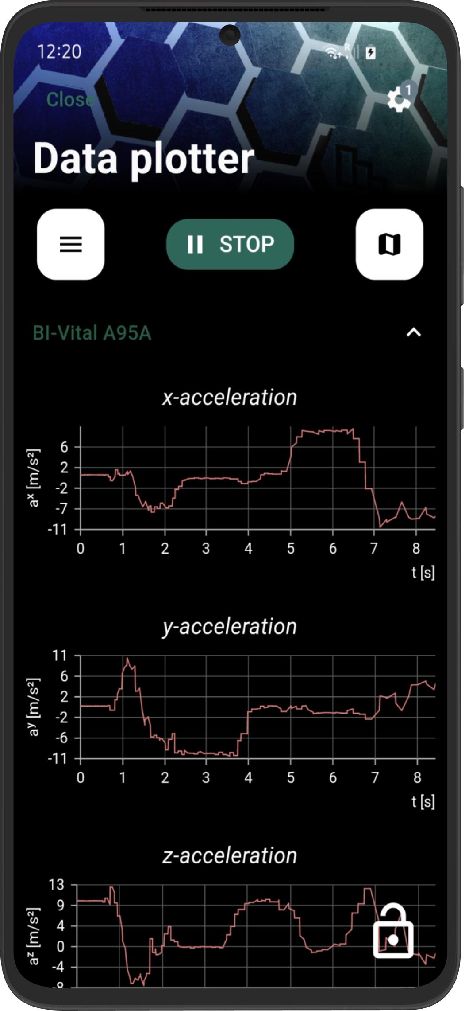
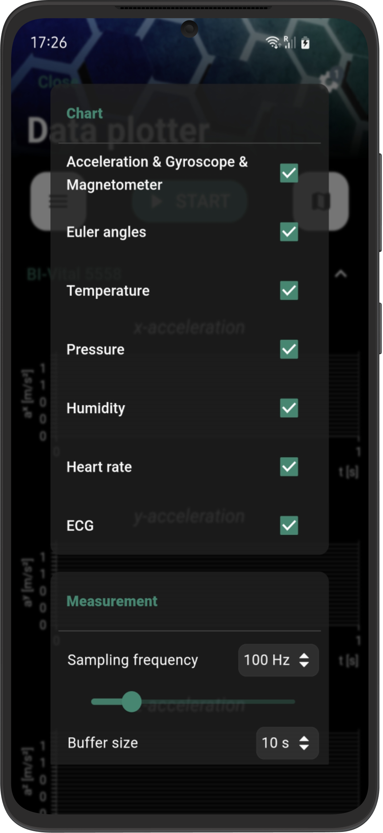

Slide 9
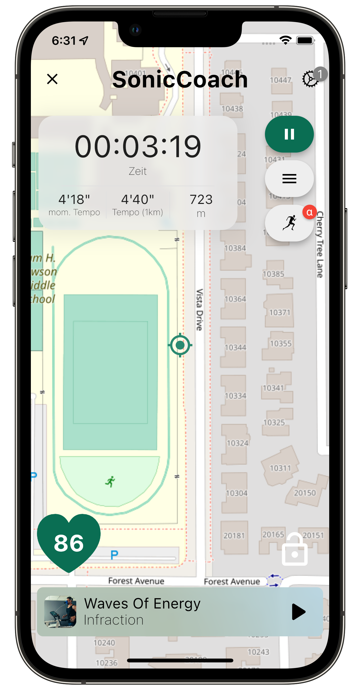

Slide 10

Flutter Software Development Kit
Notes:
https://flutter.dev/showcase

Slide 11
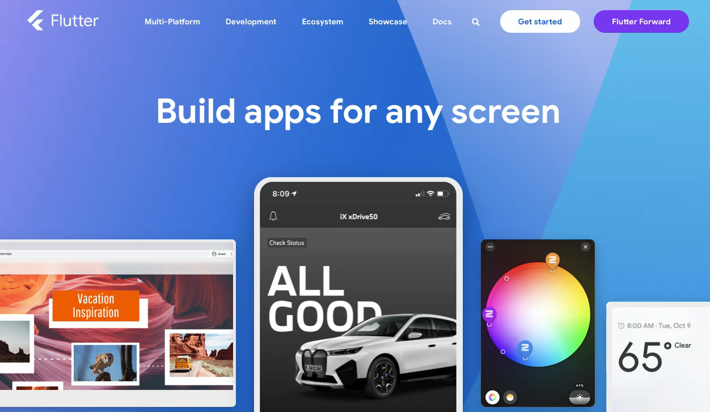

Slide 12
Open-Source
Notes:
Google, but many private people -> up- but also downsides

Slide 13
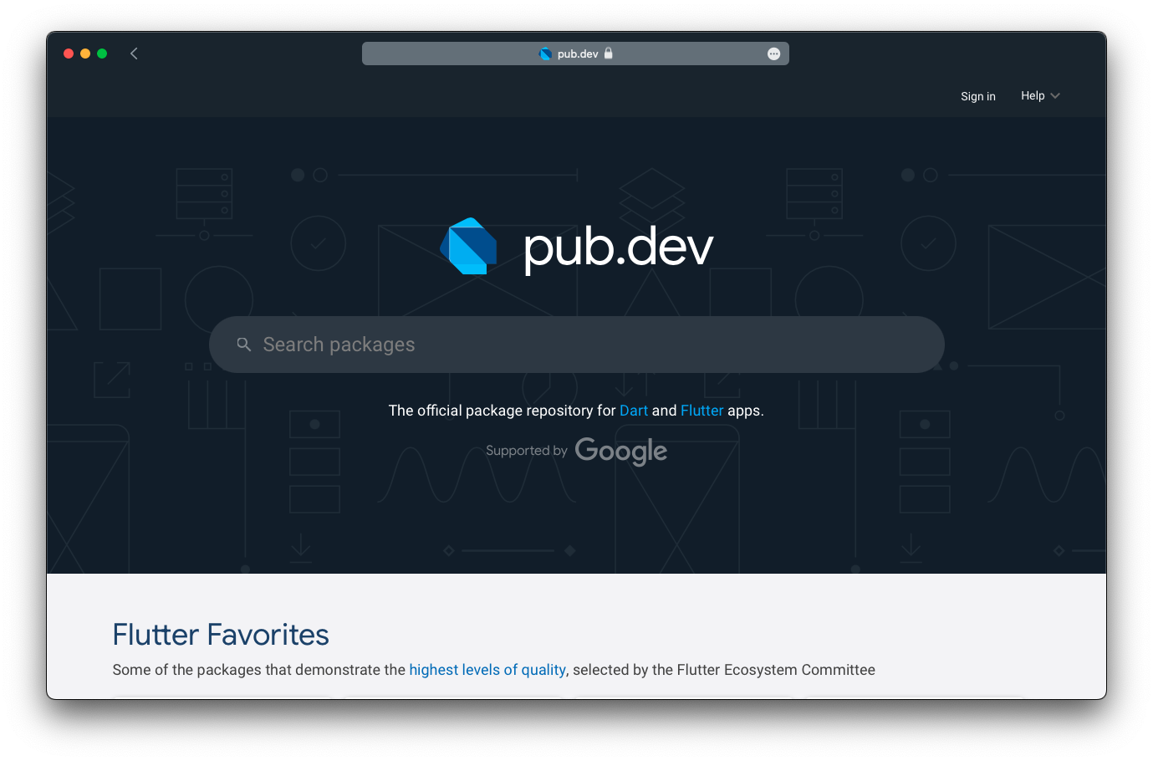

Slide 14
Cross-Platform
Notes:
at compilation --> native code (Kotlin, Swift etc.) --> native performance
control over the entire screen

Slide 15
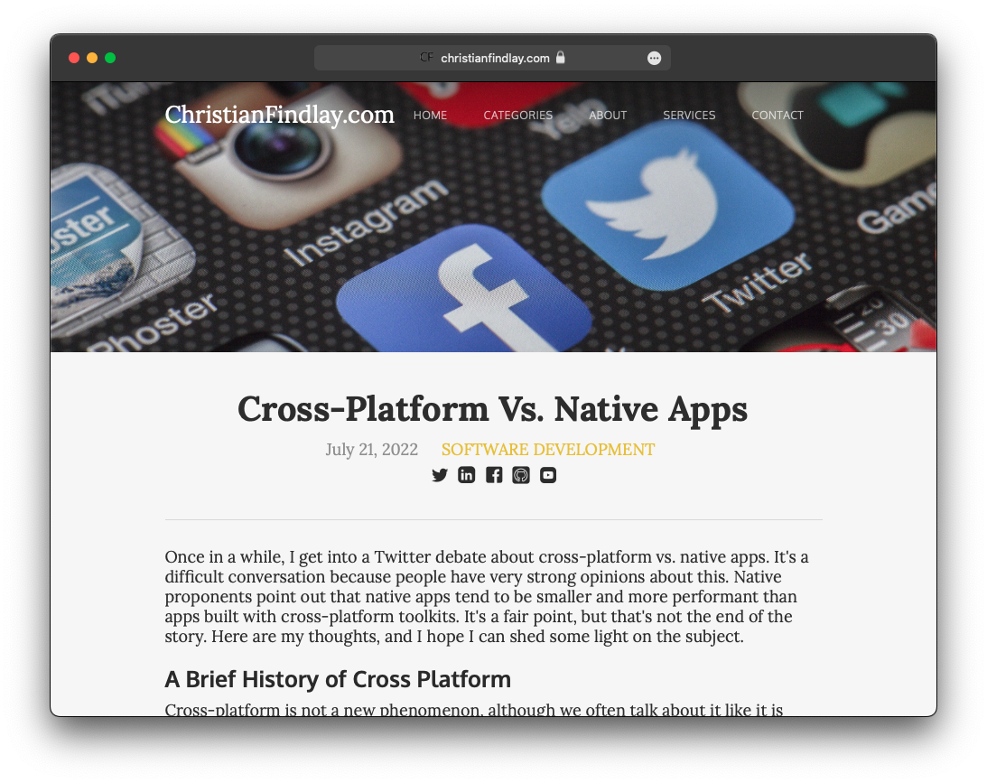
Notes:
https://www.christianfindlay.com/blog/cross-platform-vs-native

Slide 16





HUGE COMMUNITY

Slide 17

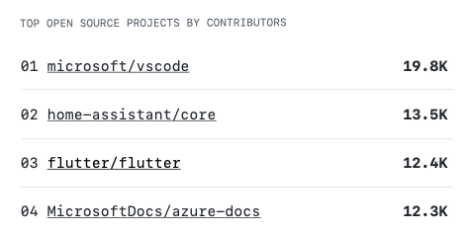
Notes:
2022 war Flutter das drittgrößte Open-Source Projekt, gemessen an der Zahl der Mitwirkenden.

Slide 18


Slide 19
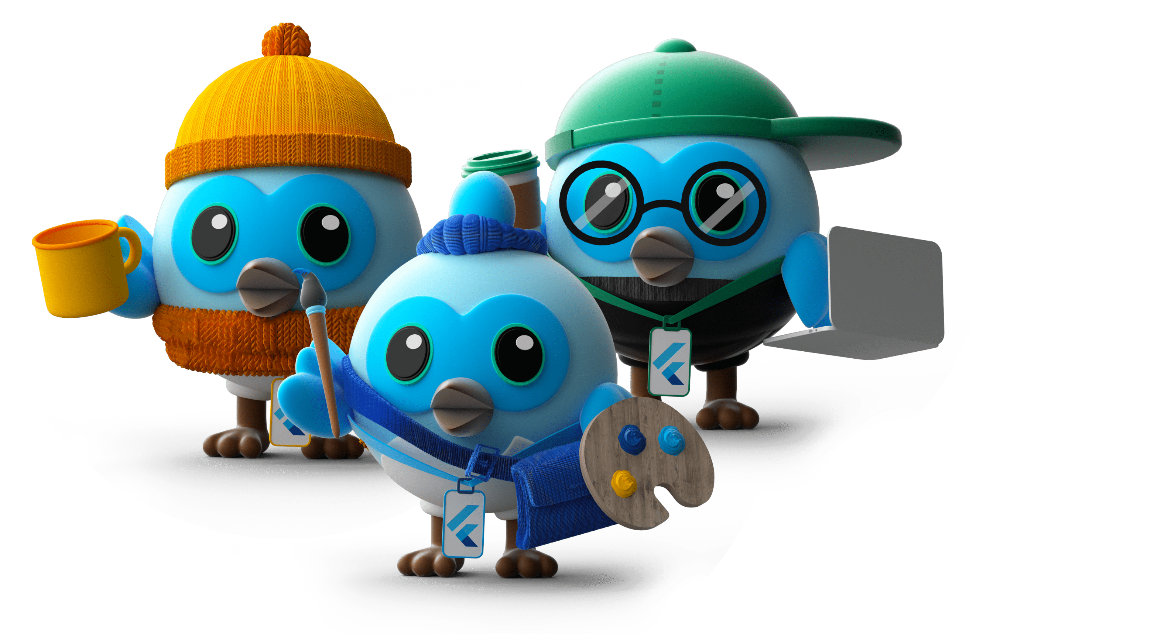
Easy to Learn

Slide 20

Object-oriented
b
Notes:
all objects are instances of classes
but also top-level variables, constants and functions (like in procedural and functional languages)
Everything is Widget

Slide 21
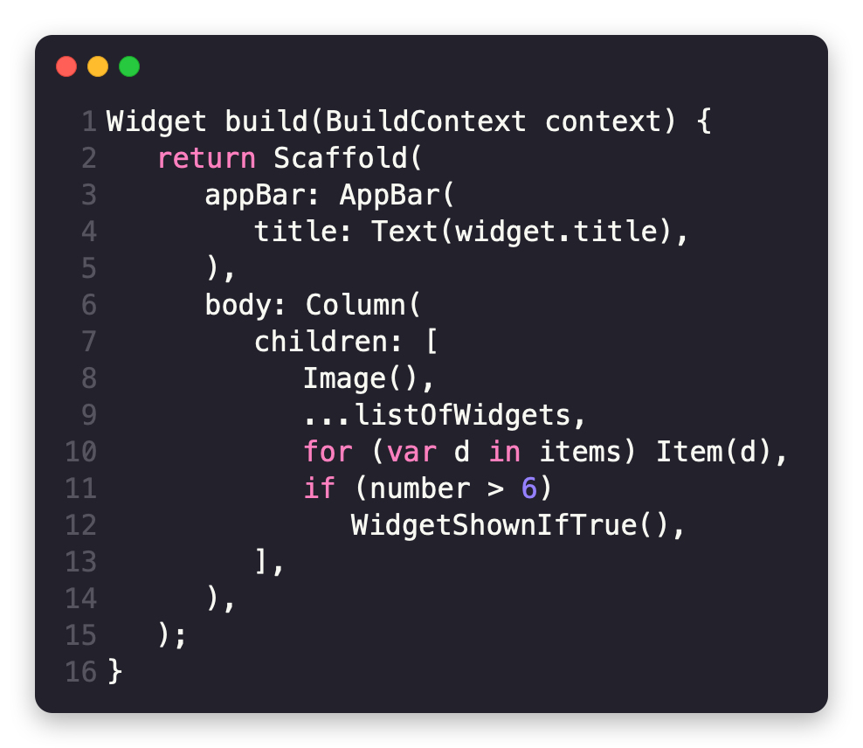
Notes:
dartpad.dev

Slide 22
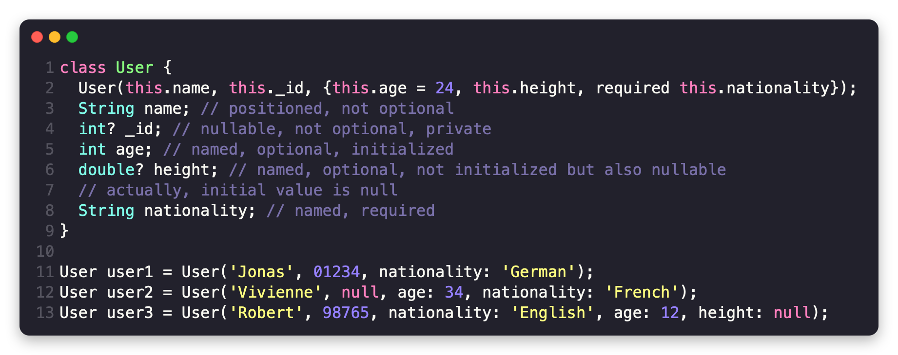
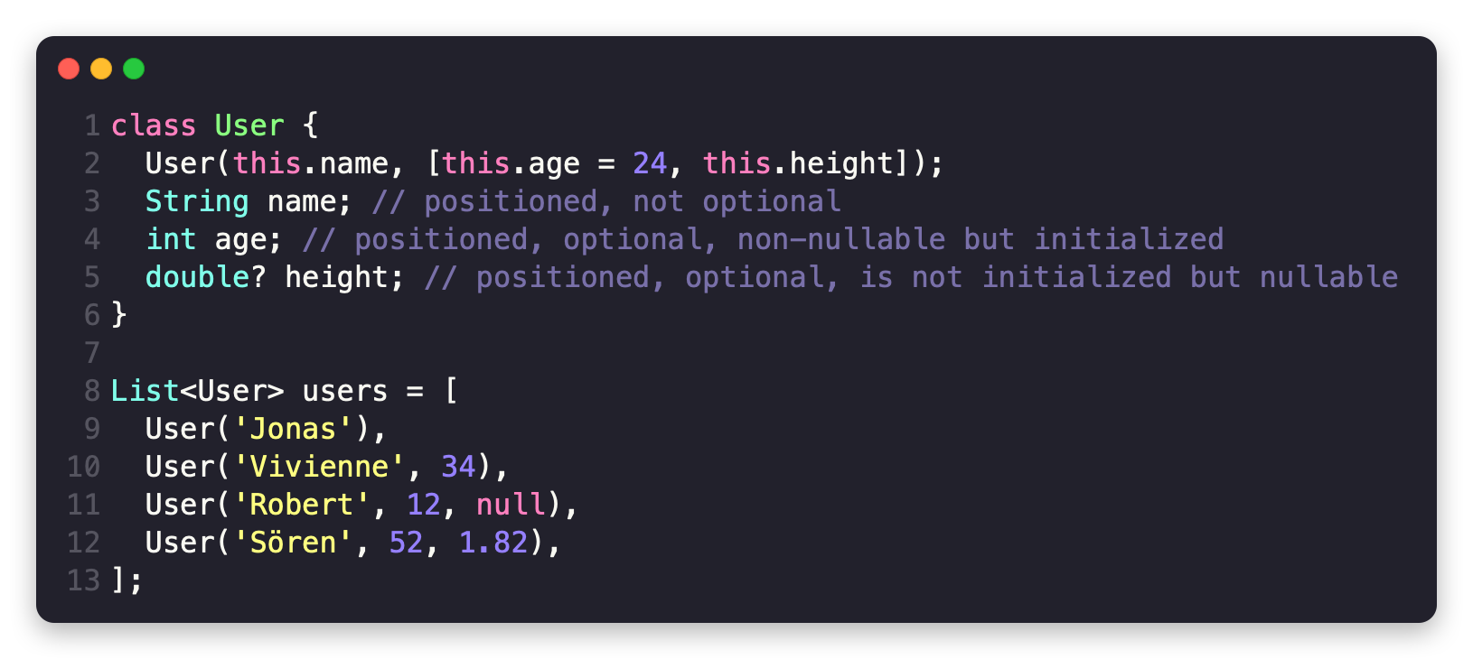
Notes:
all objects are instances of classes
but also top-level variables, constants and functions (like in procedural and functional languages)
Everything is Widget

Slide 23
backend + frontend zusammen
Notes:
(no xml files) --> stateful hot reload + hot restart

Slide 24
Optimized for UI

Slide 25
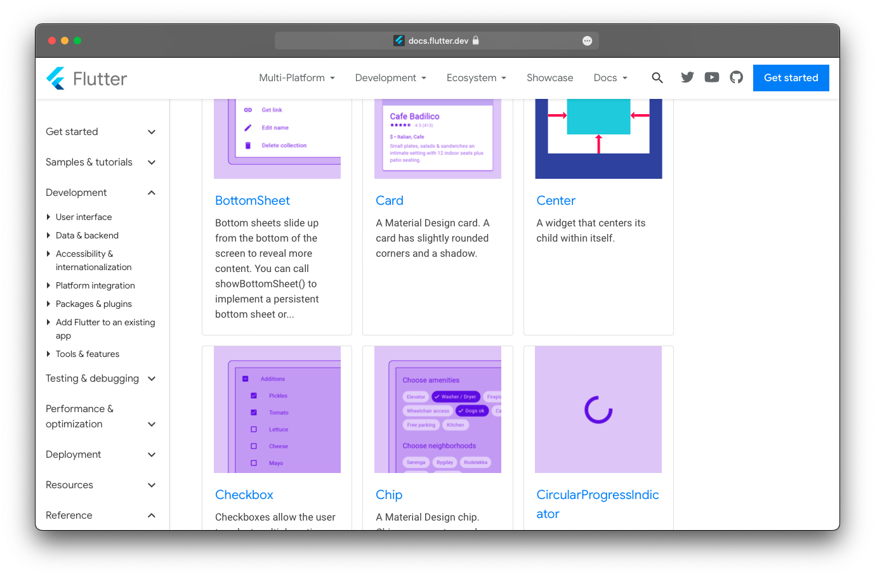

Slide 26

Sound Null Safety

Slide 27
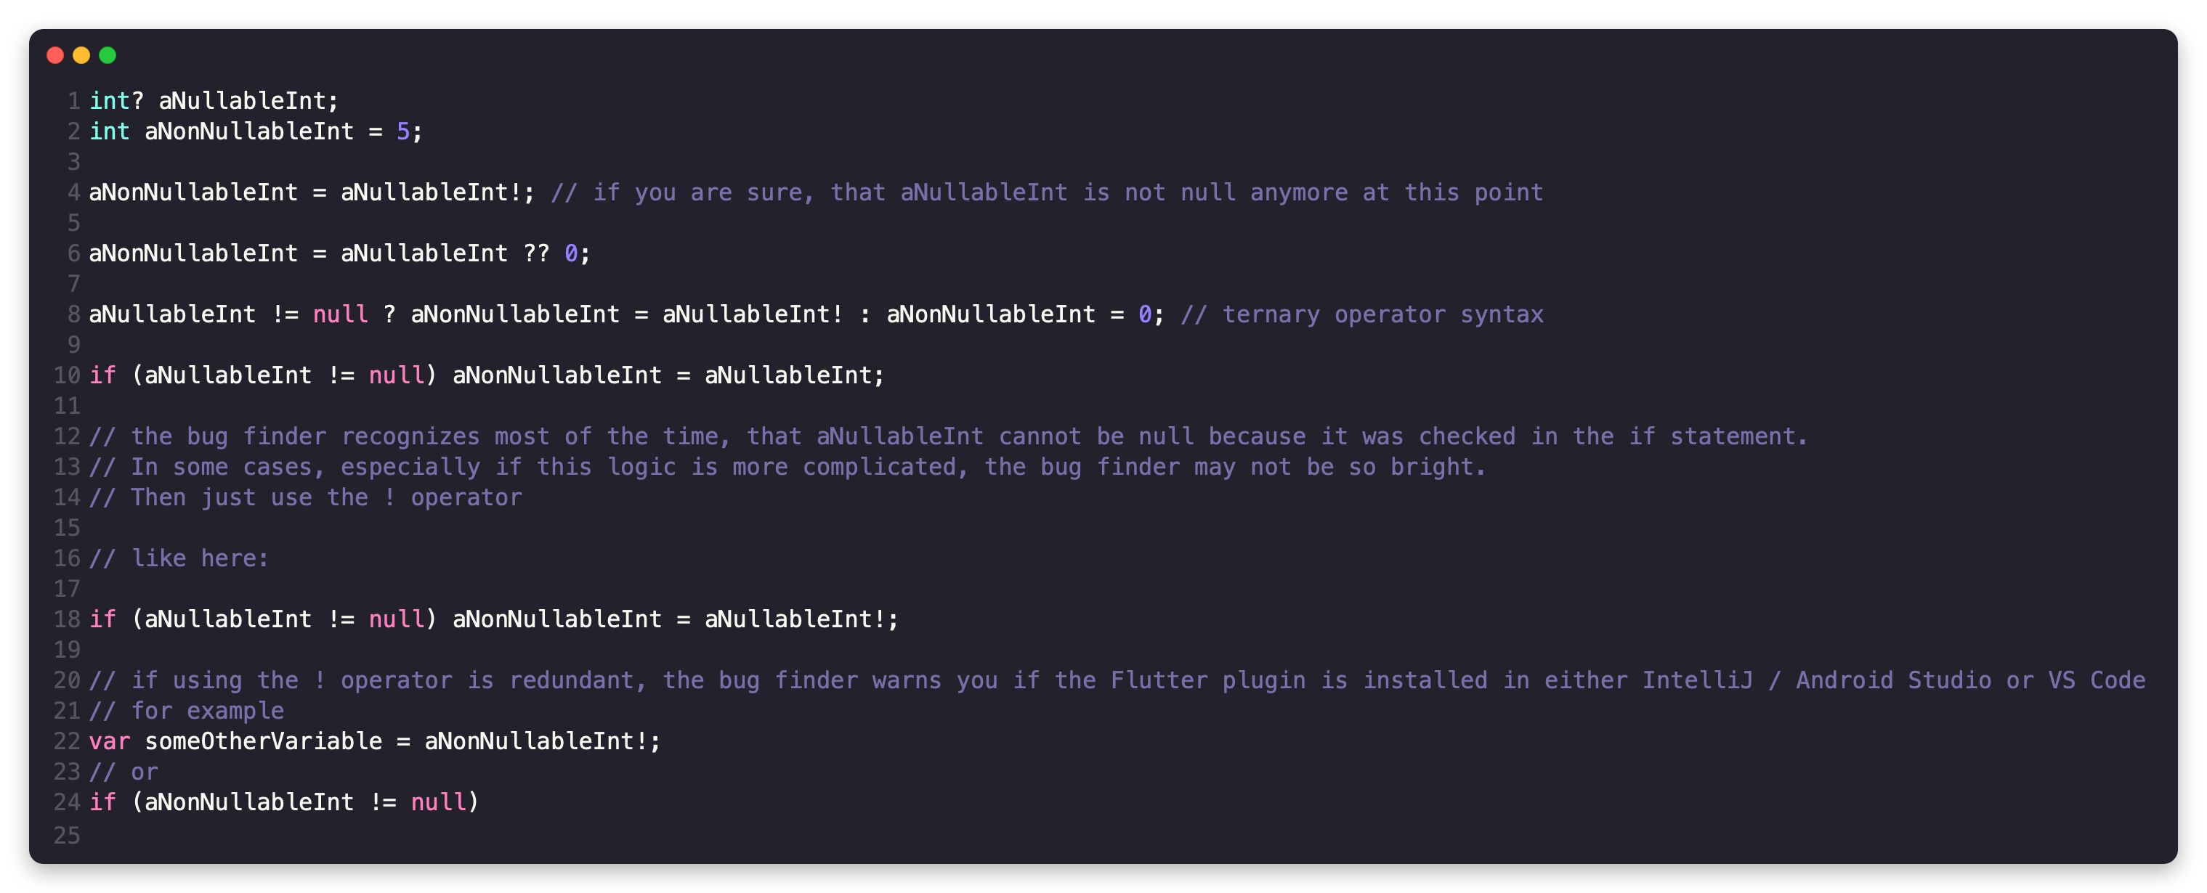

Slide 28
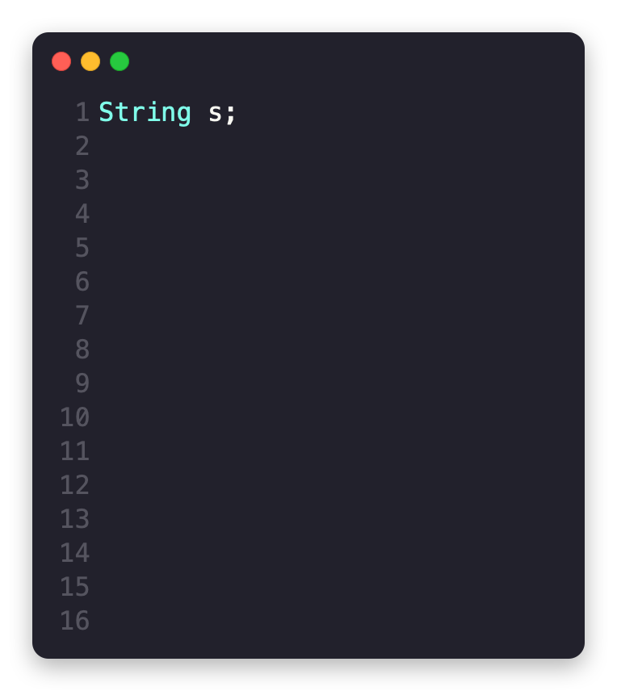

Slide 29
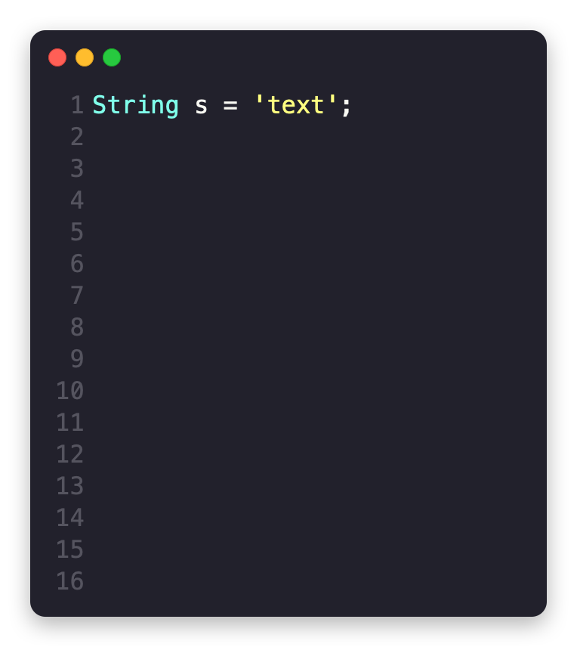

Slide 30
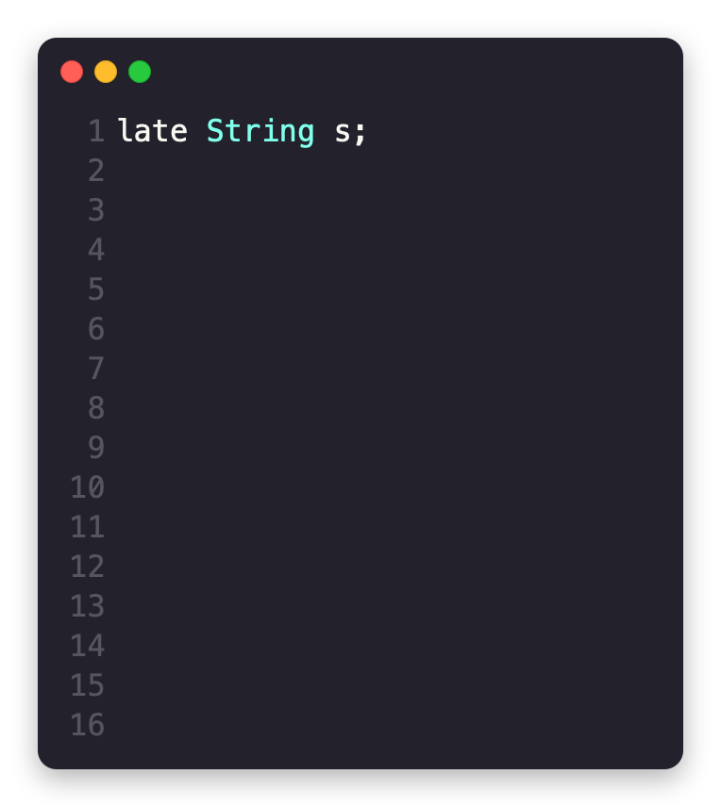

Slide 31
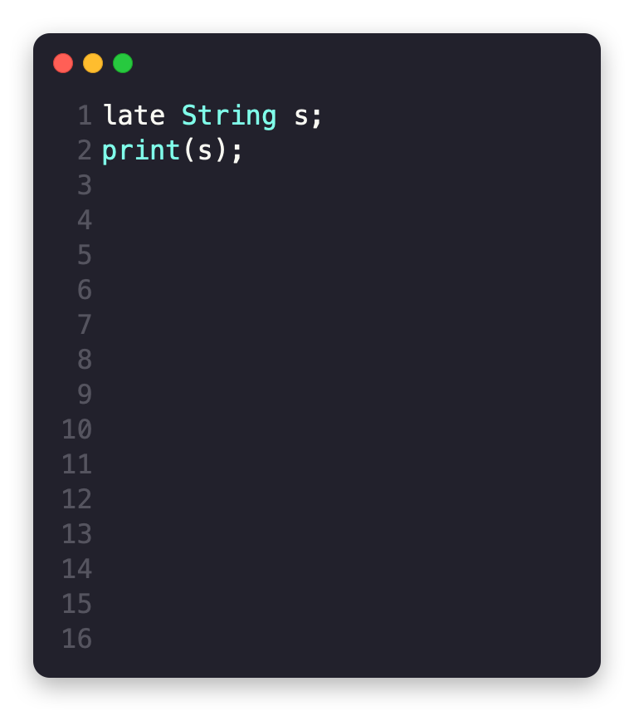

Slide 32
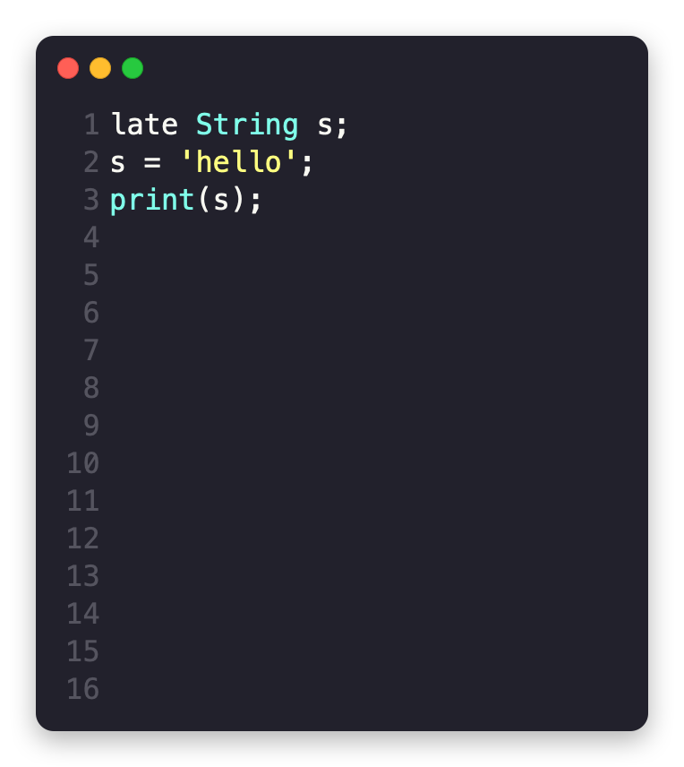

Slide 33
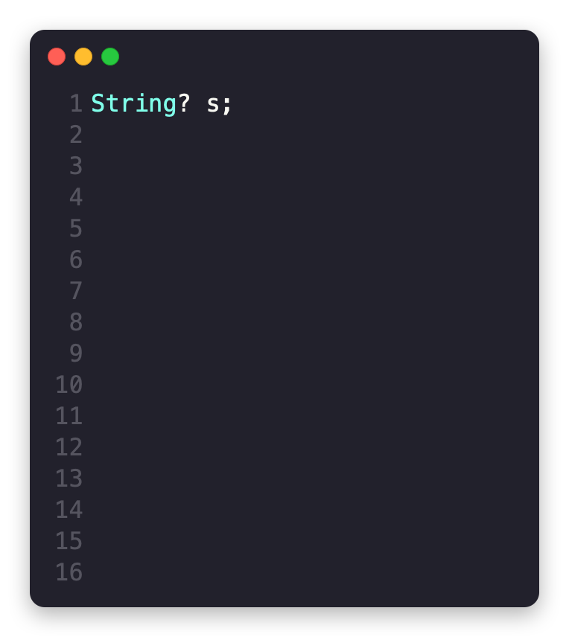

Slide 34
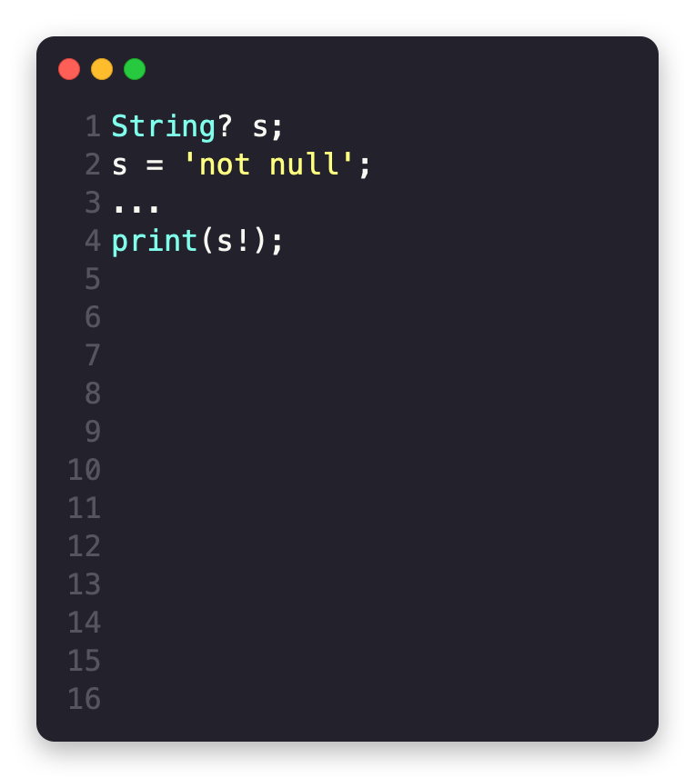

Slide 35
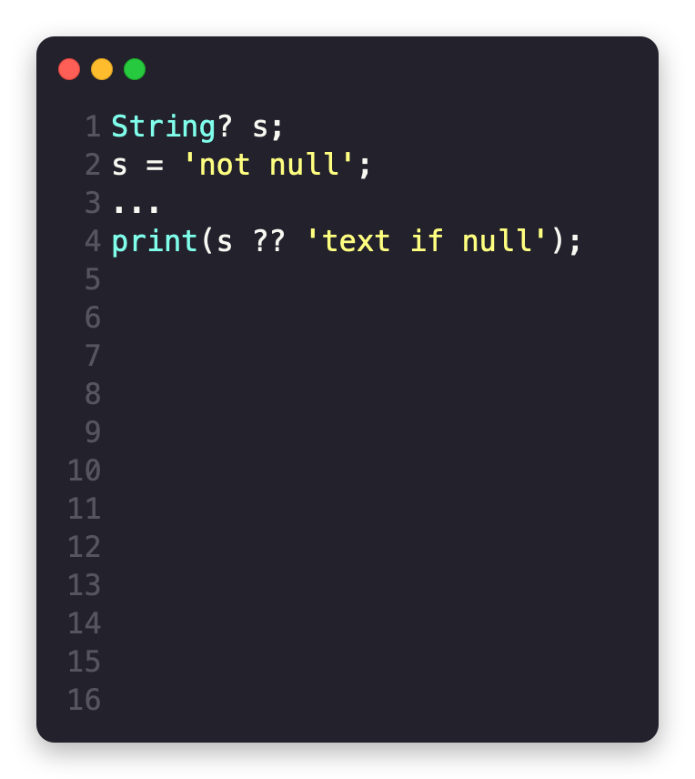

Slide 36
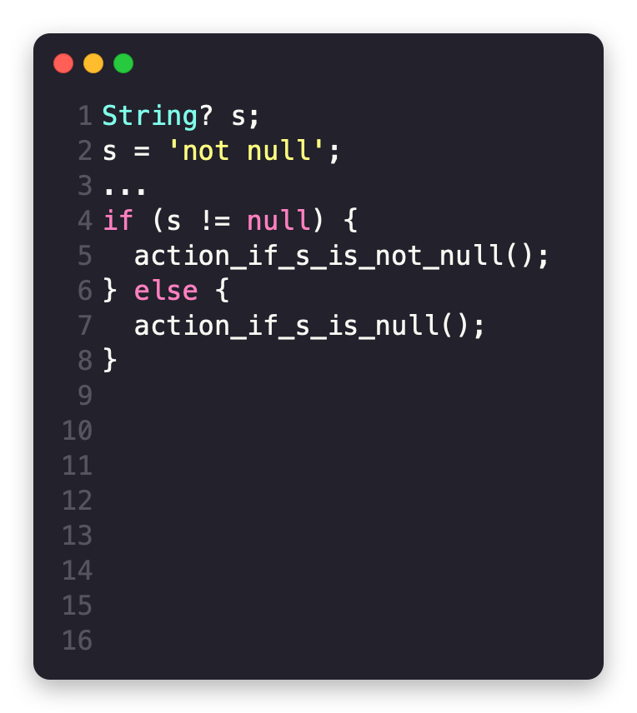

Slide 37
Asynchronous programming
ng
Notes:
async-await + isolate-based concurrency

Slide 38
